Slide 1

120 Columbia hill ct.
Grading Special Use Permit
Washoe County Board of Adjustment
October 3, 2019

Slide 2
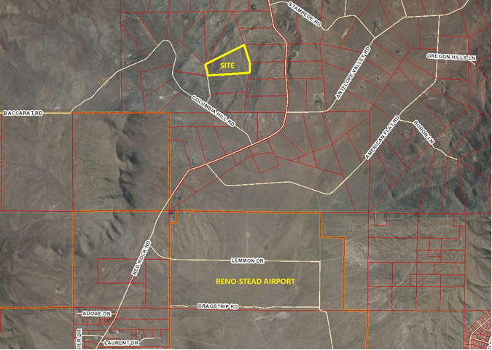
Location

Slide 3
Request
A Special Use Permit to allow for grading of a driveway and horse arena associated with a single-family residence.

Slide 4
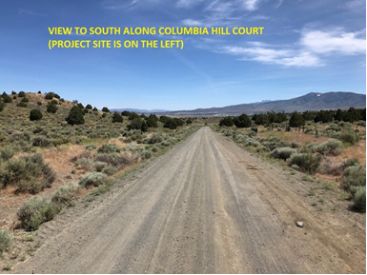
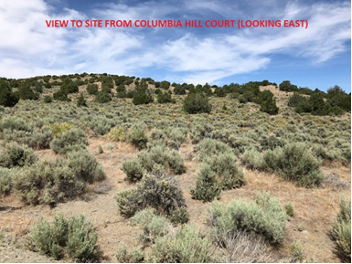
Existing conditions
The proposed driveway was graded several years ago (prior to the applicant acquiring the property).
This project uses the existing roadway as much as possible.

Slide 5
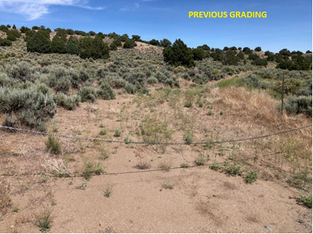
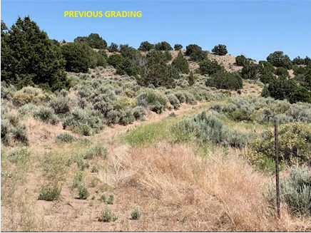
Existing conditions
Existing informal grading was not necessarily completed to County standards.
This project will bring it into compliance.

Slide 6
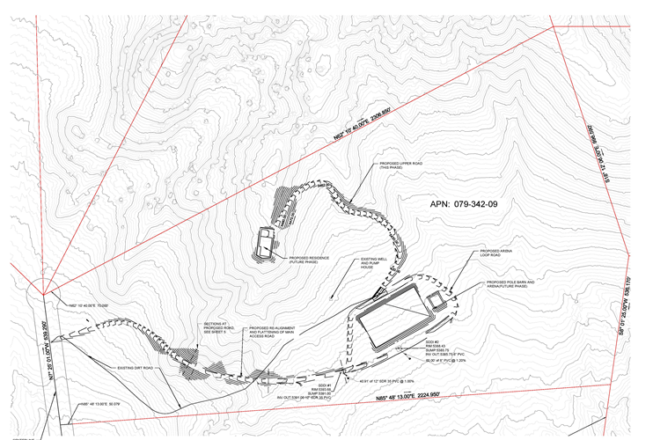
Site plan

Slide 7

Summary
Grading to be completed in 2 phases:
  Phase 1 – Driveway and House Pad.
  Phase 2 – Arena and Barn.
  - Proposed grading is consistent with custom homes on adjoining property and within the area.
  - Any visible cut slopes will be stabilized and revegetated with native plant materials.
  - The majority of grading can not be seen from surrounding properties.

